Slide 1
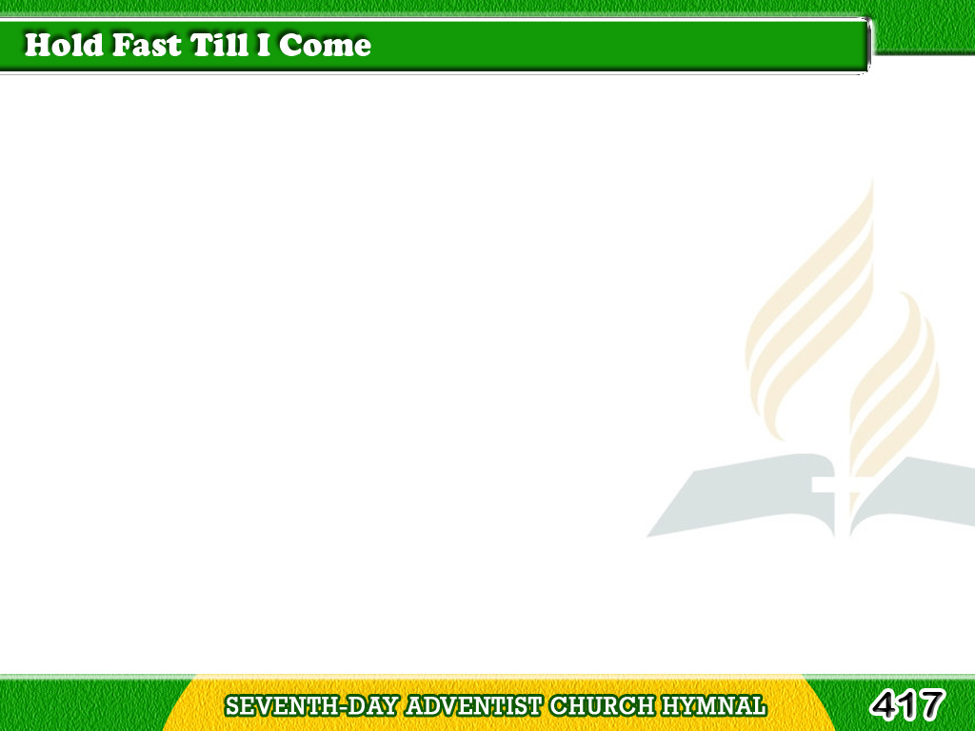
1/3
Sweet promise is given
to all who believe
“Behold I come quickly,
Mine own to receive;
Tagalog
Version

Slide 2
1/3
Hold fast till I come;
the danger is great;
Sleep not as do others;
be watchful, and wait.”
Tagalog
Version

Slide 3
1/3
Chorus
“Hold fast till I come;”
sweet promise of heaven
“The kingdom restored,
to you shall be given.”
Tagalog
Version

Slide 4
1/3
Chorus
“Come, enter My joy,
sit down on My throne;
Bright crowns are in waiting;
hold fast till I come.”
Tagalog
Version

Slide 5
2/3
We’ll “watch unto prayer”
with lamps burning bright;
He comes to all others
a “thief in the night.”
Tagalog
Version

Slide 6
2/3
We know He is near,
but know not the day
As spring shows that
summer is not far away.
Tagalog
Version

Slide 7
2/3
Chorus
“Hold fast till I come;”
sweet promise of heaven
“The kingdom restored,
to you shall be given.”
Tagalog
Version

Slide 8
2/3
Chorus
“Come, enter My joy,
sit down on My throne;
Bright crowns are in waiting;
hold fast till I come.”
Tagalog
Version

Slide 9
3/3
Yes! This is our hope,
‘tis built on His word
The glorious appearing
of Jesus, our Lord;
Tagalog
Version

Slide 10
3/3
Of promises all,
it stands as the sum:
“Behold I come quickly,
hold fast till I come.”
Tagalog
Version

Slide 11
3/3
Chorus
“Hold fast till I come;”
sweet promise of heaven
“The kingdom restored,
to you shall be given.”
Tagalog
Version

Slide 12
3/3
Chorus
“Come, enter My joy,
sit down on My throne;
Bright crowns are in waiting;
hold fast till I come.”
Tagalog
Version

